Slide 1
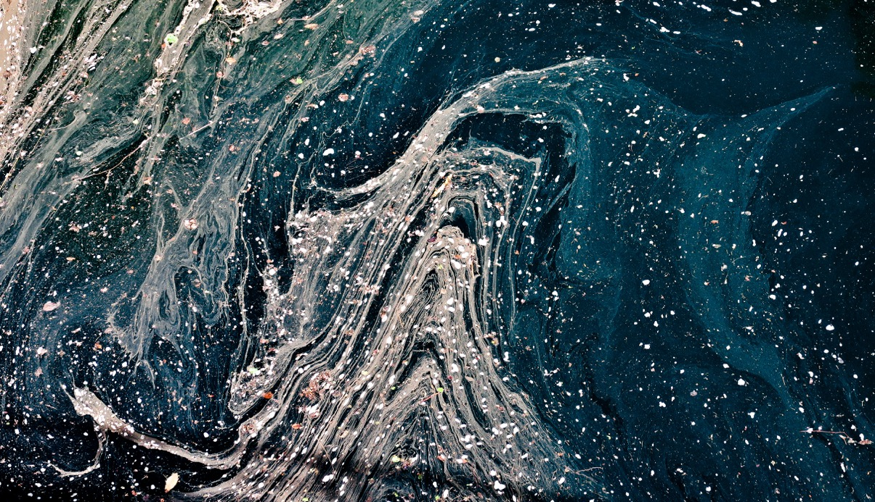

Presented by:
The jata solutions
California Water Data Challenge
Empowering community residents with
One integrated information platform and Two-way data communication
Notes:
Welcome to the jata water solutions, project created for the California Water Data Challenge 2019!
The main purpose of our project is to empower all California community residents with one integrated drinking water information platform and two way data communication system.
By saying integrated, it means that you have the one-stop access to all the drinking water quality data that’s relevant to you and your community. As long as you know your home address, you get your home tap water quality information.
And the two way data communication means that besides receiving information, our platform allows you to share your water quality data back to the government leaders and other stakeholders among your community.
If it sounds quite simple to understand what I described so far, we are half way achieving our goal.

Slide 2
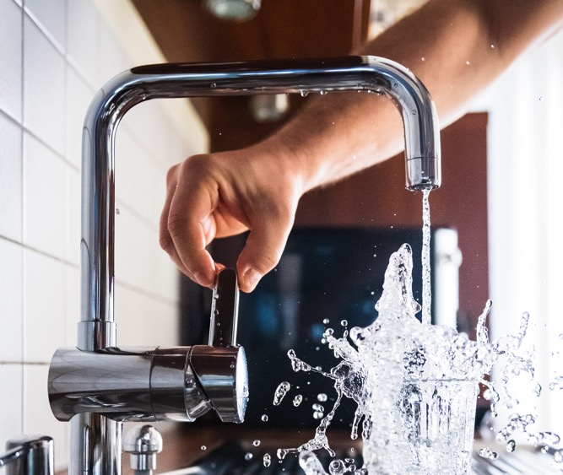
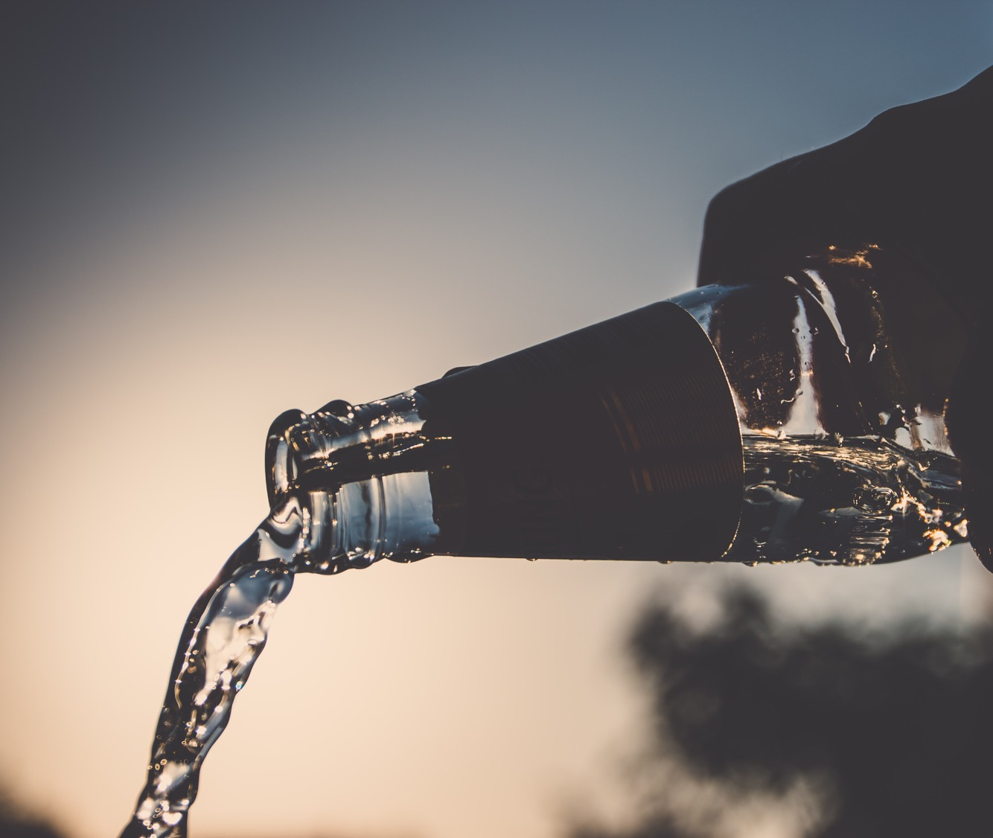

Strengthening Data-Enabled Communication: Building Awareness and Engagement
How might we communicate data-driven insights to a broad audience?
What tools and methods can help stakeholders communicate effectively, providing context and transparency?
How can we make open water data “come to life”, inspiring a diverse range of community members to get involved?
Notes:
for the California Water Data Challenge 2019, our project falls in the third challenge category which is about strengthening Data-Enabled Communication and hopefully we can answer these questions by the end of our presentation.

Slide 3
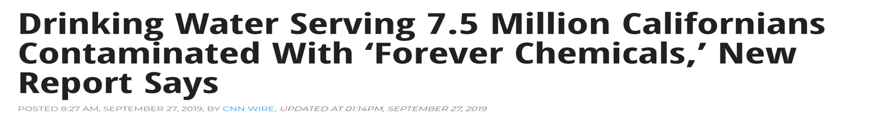
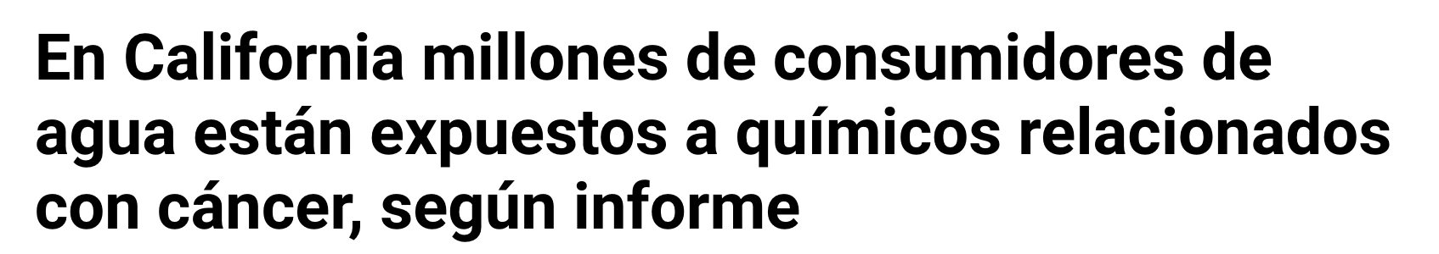
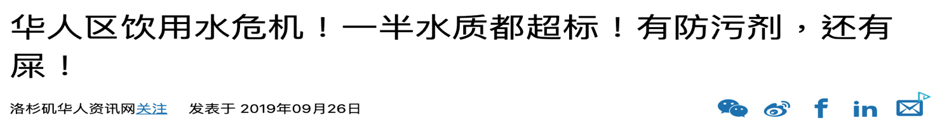
Notes:
Most of the california residents probably have seen presses like these on media lately or in the last few years.
So When people read an article like these, what thought may come to them?

Slide 4
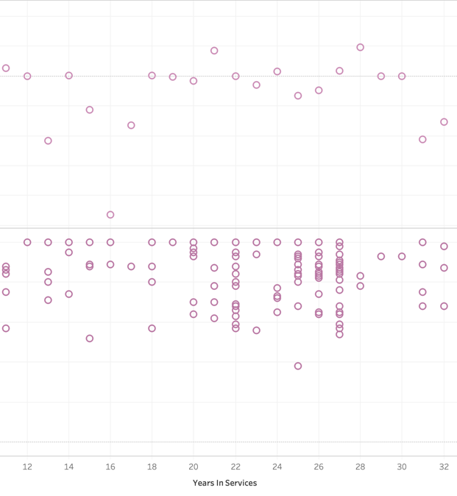

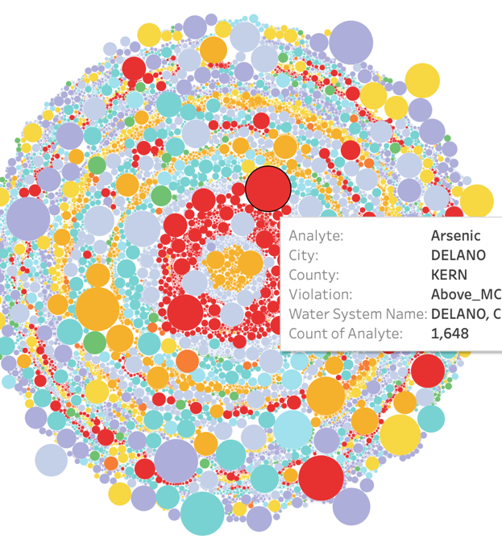
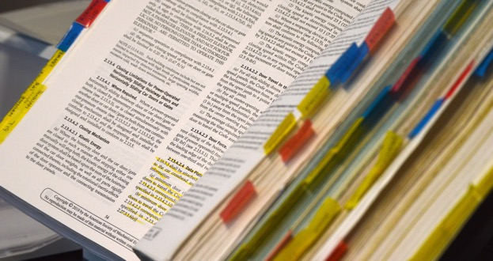
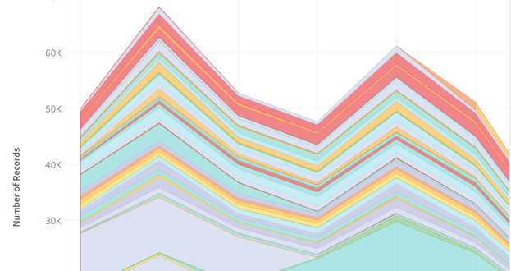
What would you do?
Notes:
A data scientist probably will go to the government open data portals and start looking into some data.
A highly educated person may start researching online for supportive data analysis or paper to better understand the situation.
But what about an ordinary person who doesn’t have data literacy or even web literacy?

Slide 5
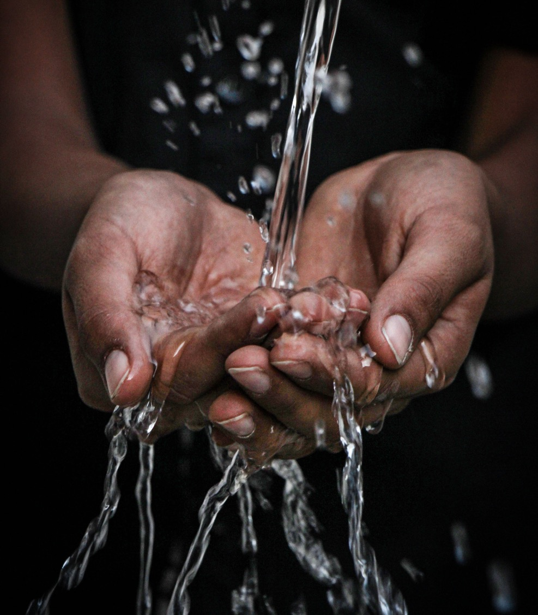
"What can I do if I’m concerned about my drinking water quality?”
"HOW do I find out if the water I am drinking meets the drinking water quality standard?"
Notes:
"HOW do I find out if the water I am drinking is safe?"
And
"What can I do if I’m concerned about my drinking water quality?”
These two are probably the most frequently asked questions by a California resident after reading an ambiguous news about water crisis in California
And these are the questions we want to answer WITH our project.

Slide 6
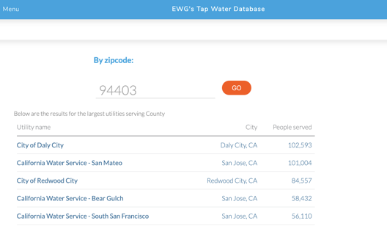
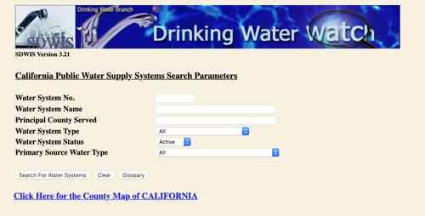
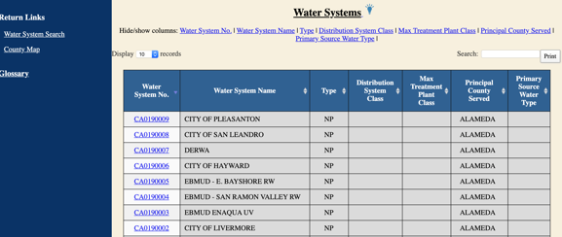

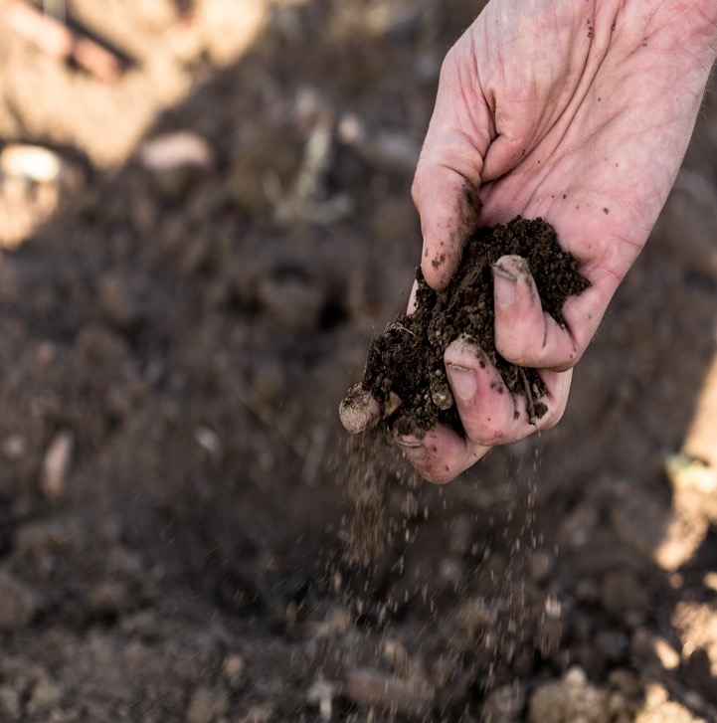
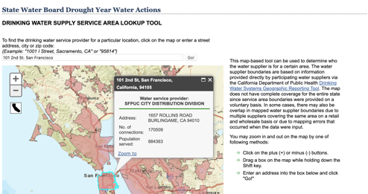
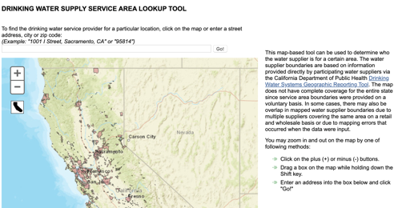
1. Information silo 2. Data navigation 3. Complexity of domain knowledge
The REAL data challenges
Notes:
We start our project from navigating the data portals and discovering what are already out there.
We find three separate websites that combined may lead to an answer for the first question we try to answer, how to find out if my drinking water is safe to drink.
The first website we looked at, allow us to get a list of water systems that served in or near our neighborhood by entering the zip code. Then it tells ME what chemicals had been detected in those water systems previously. But how do I know which exact water system is serving me my drinking water?
The second one allows us to view the water quality reports in details by entering a water system number. But again, how do I know what my water system number is?
By entering my home address, the third site mapped me to the water system/or water district that is serving me water. But THE INFORMATION stopped there. It displayed some general information about the water system, BUT the water quality data that we actually care is unavailable on this site.
After a few days of searching, we realize how hard it is to answer this simple question WITH THE existing resources.
All those websites either OWNED by the government or A nonprofit ARE GREAT WITH LOTS OF INFORMATION, imagine how convenient and effective it can be when these three sites are combined.

Slide 7


Solution: ONE Integrated Platform
Integrated
Straight
forward
Easy to understand
Data silo
System navigation
domain knowledge
Complexity
Notes:
So we decided to build a one stop integrated information platform that breaks the data silos, and is easy to use, A platform that provides you only a tiny piece of information that’s relevant to you.

Slide 8
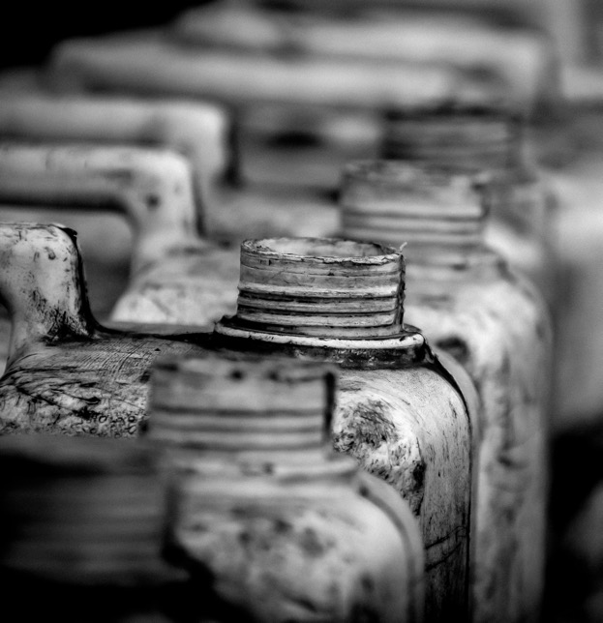


The REAL challenge "WHAT can I do if I’m concerned about my drinking water quality?”
Notes:
After checking my water quality data, unfortunately, if i find out the water quality in my water system have multiple chemicals detected previously, which makes me concern about my water quality. Then What can i do?
Maybe i could test my own water with some commercial home test kit to confirm or erase any of my concern. if it’s so obvious that my tap water does not even look or smell safe, i probably want to voice my concerns to the government or the water supply company and engage my community for possible solutions.

Slide 9
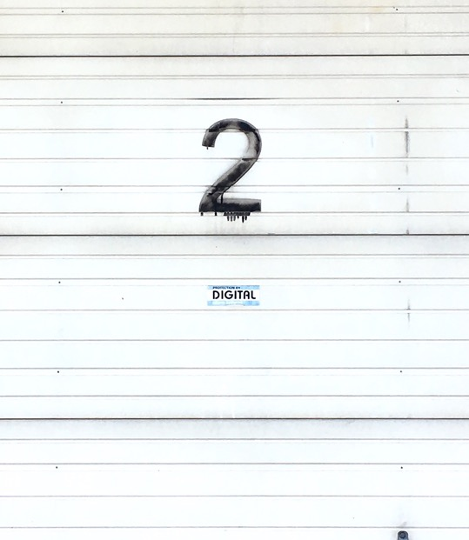

Solution: TWO-WAY data communication between city open data AND public
Notes:
So on top of the information platform we created a feature to allow people to share their self monitoring test results and their concerns on our application. People that are served in the same water system can see the results of others. Government and the water company can also use the shared information to faster target the water problem and solve it.

Slide 10
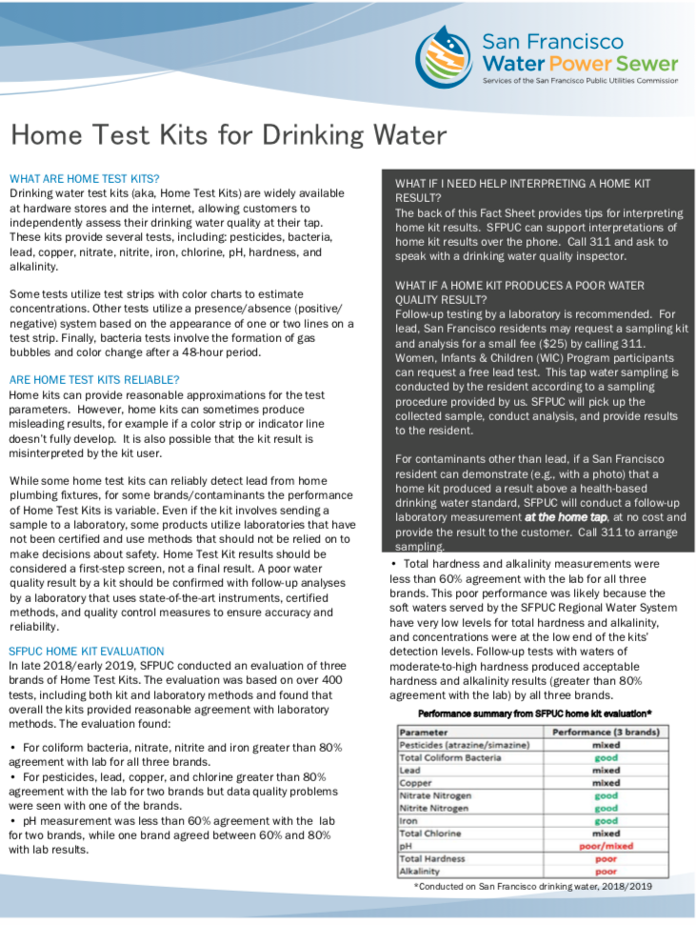


Know your water Share your results
Discover solutions with collective wisdom Raiser awareness and build engagement
Notes:
For example, in the San Francisco area, the public utilities commissioner encourages their residents to monitor their tap water quality with home test kits.
Residents can call to schedule a follow up laboratory measurement for free or at a low price if any poor result is found.
And our goal is through our two way communication platform, all stakeholders in the same community can discover solution with a collective wisdom to solve the water problem.

Slide 11

The importance of an integrated, two-way data communication platform
The water crisis is a systemic challenge. An integrated information platform allows all stakeholders to work together effectively with context and transparency.
Data communication should go both ways. Residents sending information back to the government and share within their community co-create useful public information which help recognize and solve the problem in a more efficient way.
Promote the concept of self monitoring and solving problem with collective wisdom.
Notes:
It is important to have an integrated, two-way data communication platform
The water crisis is a systemic challenge. An integrated information platform allows all stakeholders to work together effectively with context and transparency.
Data communication should go both ways. Residents sending information back to the government and share within their community co-create useful public information which help recognize and solve the problem in a more efficient way.

Slide 12

The jata water solution
Web-base
User interactive
End to end & Streamline
City open data feed
User water data feed
Notes:
The jata water solution is a web-based application. It’s user interactive.
All you need is entering your home address. We locate your water system from the back end. The system provide you the aggregated results from the data and output your water system information, its water quality summary, and changes of some major chemicals detected value in the last few years.
all the official data and information displayed on our website is from the California open data portals, and all the shared data and information are from website users. You may use only one or both as a refernce to know you water.
Current moment, our application is still a prototype with limited data support from the open database. You may not find your water system information by entering your home address yet, as the official data file of system service boundaries is still in the process of being completed.
We will continually update our application after the competition.

Slide 13
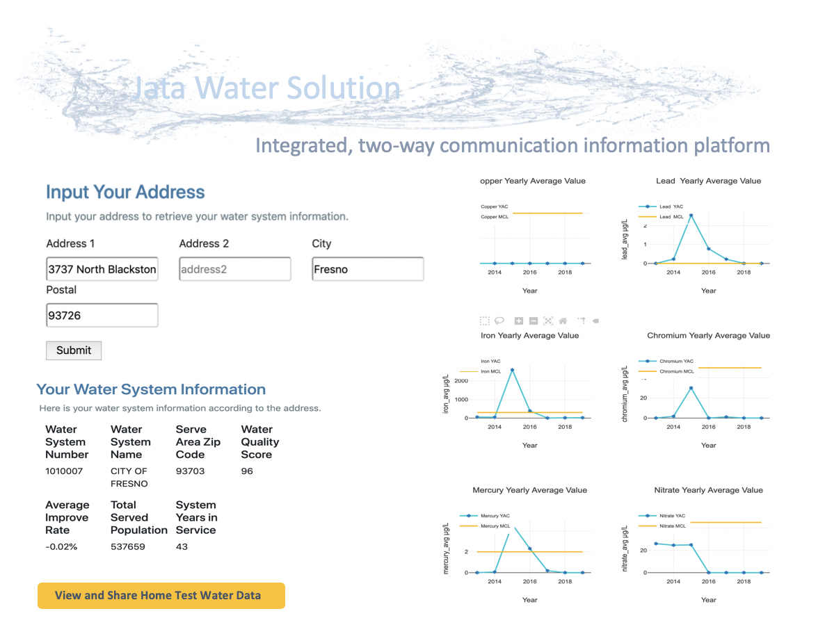
Notes:
And this is how it looks
This platform is highly configurable
You can choose data to display how to display.
Example, what residents might be interested to know.
And all the information is tied to your home address. It precise and easy to understand.
After viewing, you want to see what’s going in your nrighbood or want to share your water information that you think might be helpful to others.. You can click the view ad share….button

Slide 14
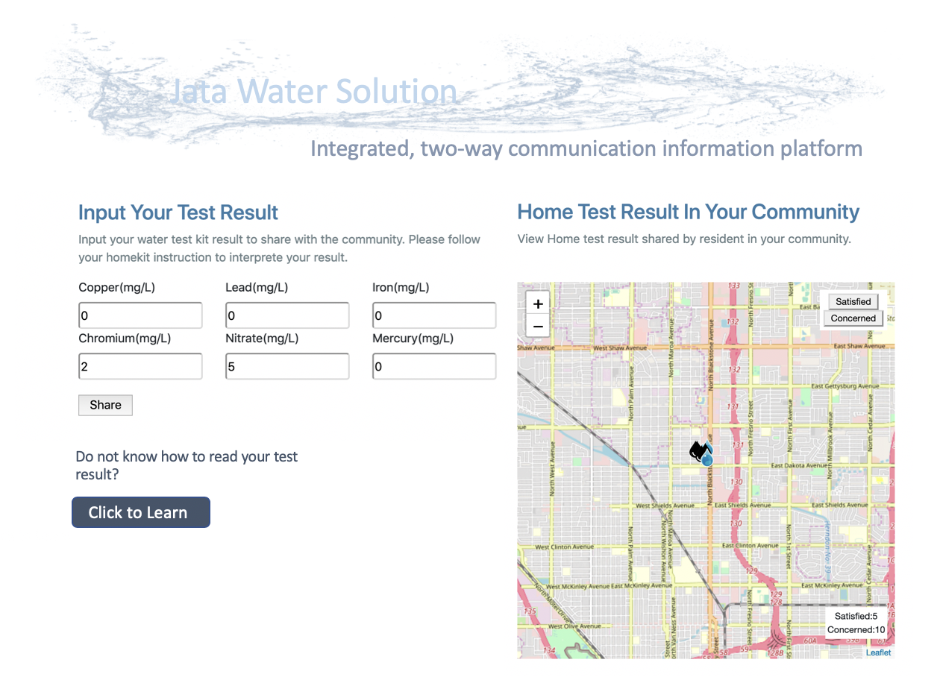
Request Sample Kit
Notes:
This is just one way to share your data, which is inputting your home water quality test kit results.
If we already have some test kit results we can simply key in the sample result number, and it can be subjective sometime.
If you we don’t have the test kits, we can request a free sample kit through the platform, the good thing about this platform, is we can even engage businesses that are in drinking water industry.

Slide 15





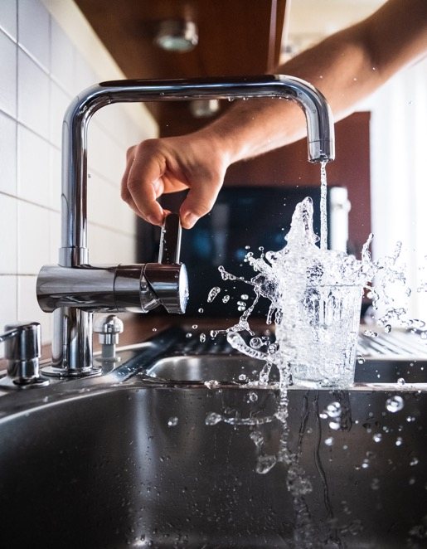

Notes:
Again, this is a platform, it may not sound perfect or scientific at all, the messages we want to deliver through our application, is about what really matters to the resident and the importance of having a centralized and integrated platform which allows everyone to work together to improve the whole process.

Slide 16


Technical difficulties
of this project
Data processing
Extract, Transform, Load (ETL)
1. Separated data sources
Outdated database file format
To create our own relational database for query
Incomplete dataset
Domain knowledge
Notes:
In the process of development, we encountered some technical difficulties and we think it might be helpful to share as well.
The biggest challenge in the data ETL process is that the original datafile we downloaded from California Open Data Portal is in dbf format which is relatively old and less an universal data file format. Extracting and transforming a vast amount of data to a relational database for analysis was challenging to us. Luckily, I was told that in the next couple of years, the data will be migrated to a different database for better data user accessibility.
Another challenge we faced was that we lack the domain knowledge to understand and interpret the water data. It would be great if data scientists, developer and water experts can all work side by side throughout the developing process.

Slide 17

Recommendation
Data update consistency
Standardize database file format
Interjurisdictional cooperation
Documentation
Geospatial data
Notes:
We have a few points on how might existing data analysis process be improved and we will go over it in the future.

Slide 18
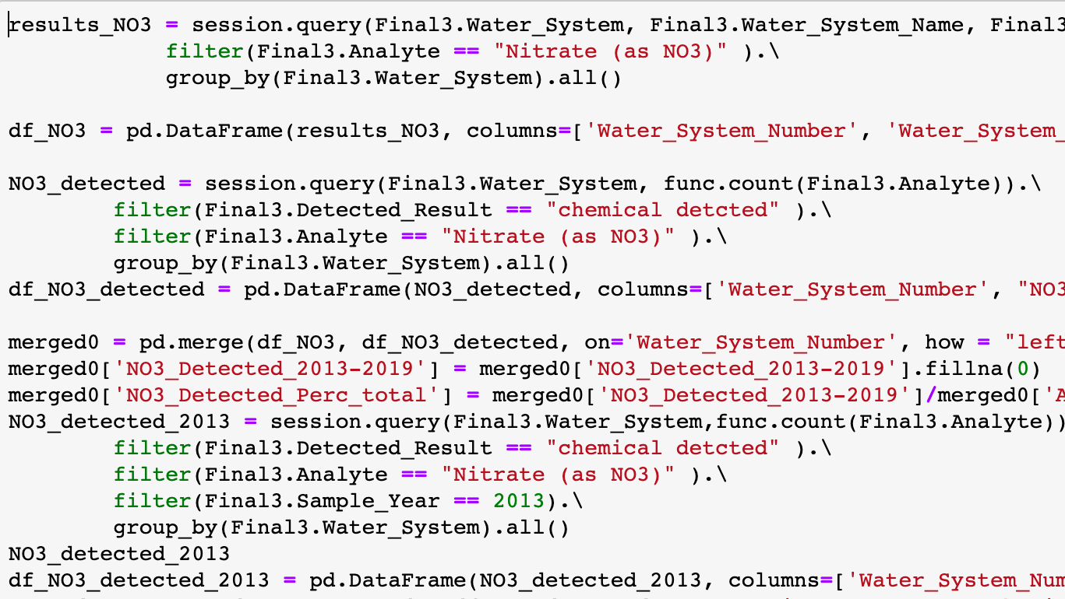
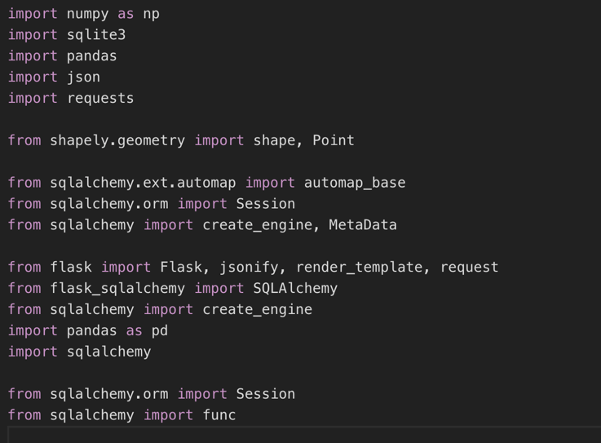
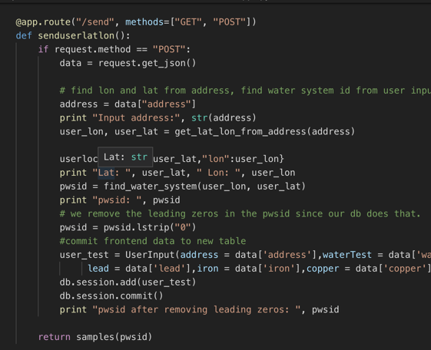
Data processing and web-development
####################################
data source: ca.gov/cnra/other
data format = {dbf: SQLite, csv: json}
data munging tools: pandas, sqlalchemy, numpy, excel, shapely
programming languages: python, JavaScript(react), HTML,CSS
data visual: [ “d3”, “plotly”, “tableau”, ”leaflet“]
hours of development Error: hours out of range
####################################
Notes:
These are the tools we used for our entire project. From data collection, back end and front end development, we built everything from scratch. For the data visualization part, you may not see all the graphic we made on the website with listed packages and software, that’s because we only want to deliver a simple and clear informational page, which focuses on only what’s relevant.

Slide 19

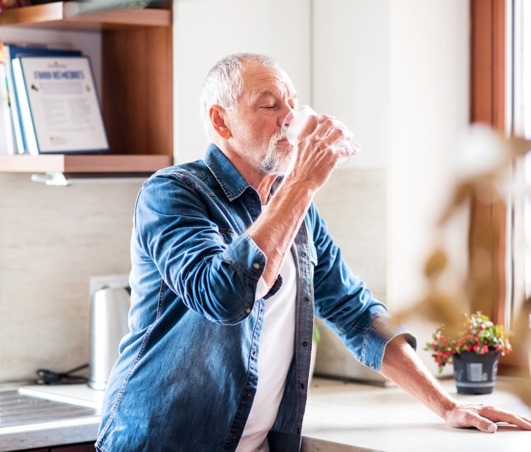


about the jata solutions
Improving people’s lives
Unlocking the potential of the open data
Offering authentic data solutions
Notes:
Data solution startup, bridging silo open city databases, discover insights

Slide 20
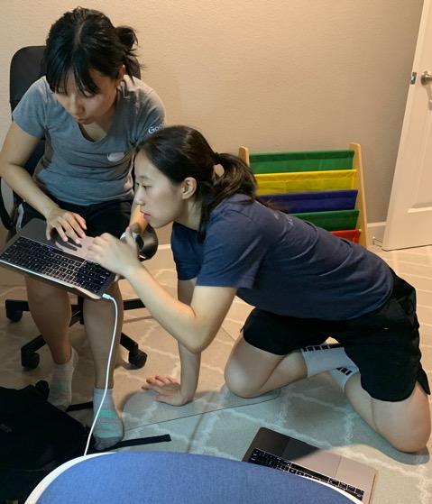
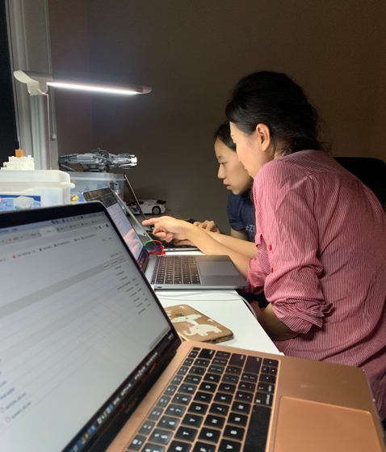
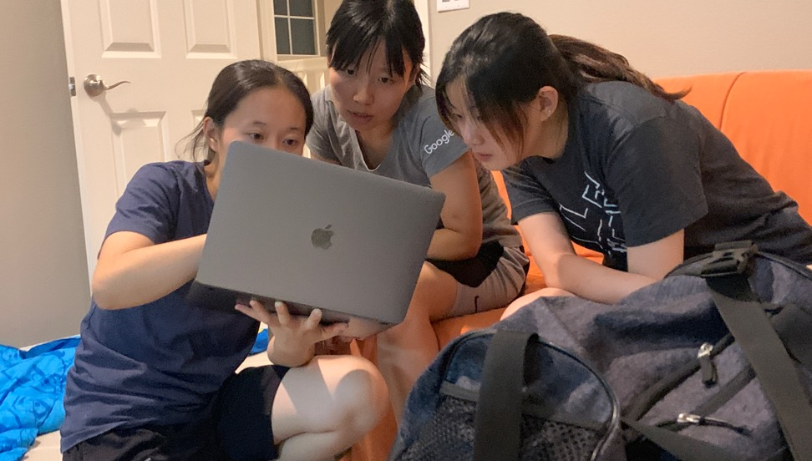
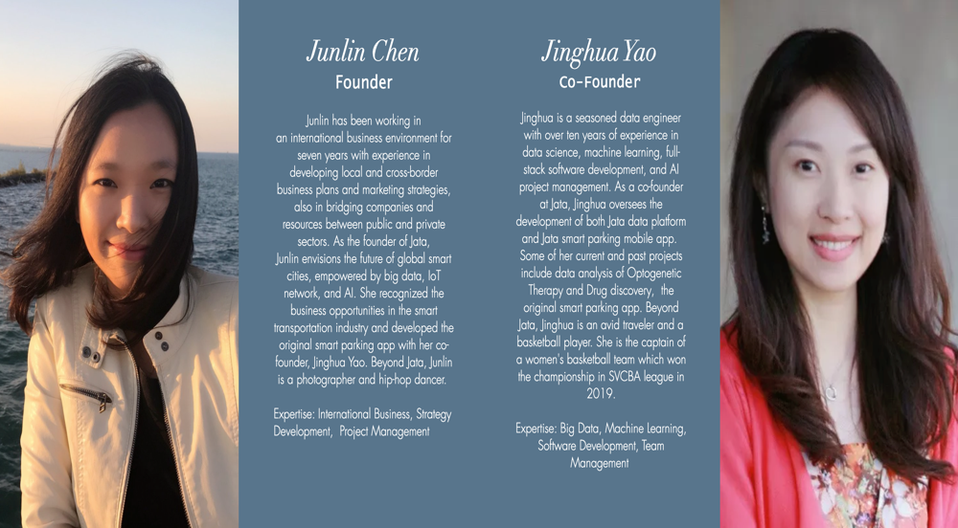
Team
Junlin Chen, Jinghua Yao, Zini Zhu, Caidan Yang
Special thanks to JiiaJia

Slide 21

Thank you

Slide 22

Demo

